Slide 1
RANKING ARRANGEMENT

Slide 2
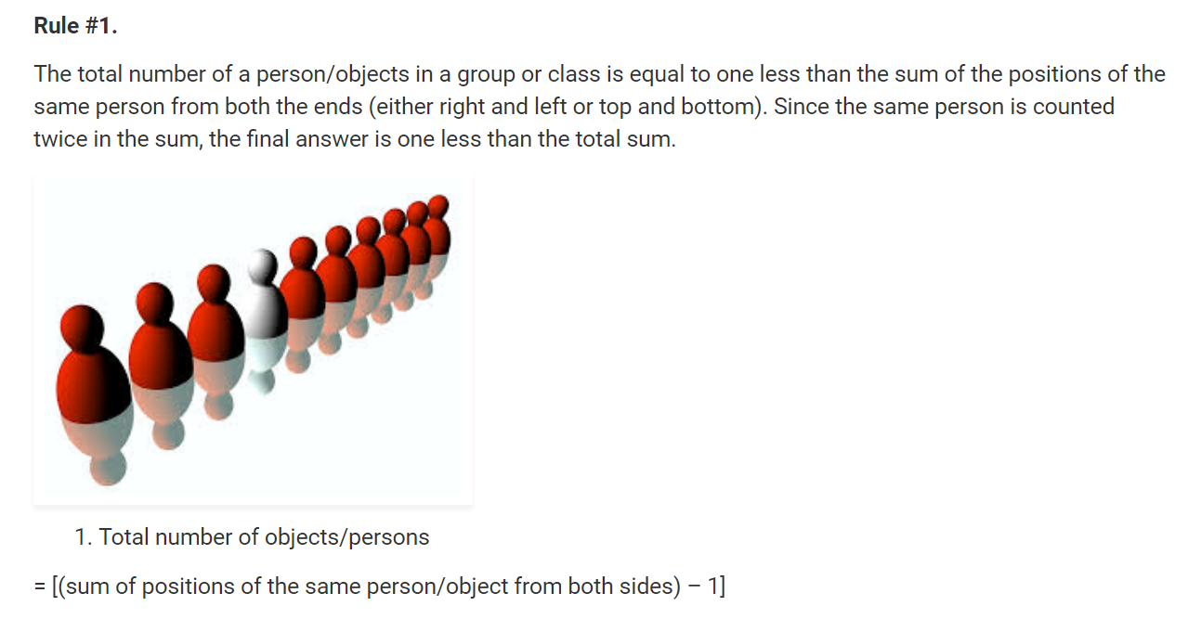

Slide 3
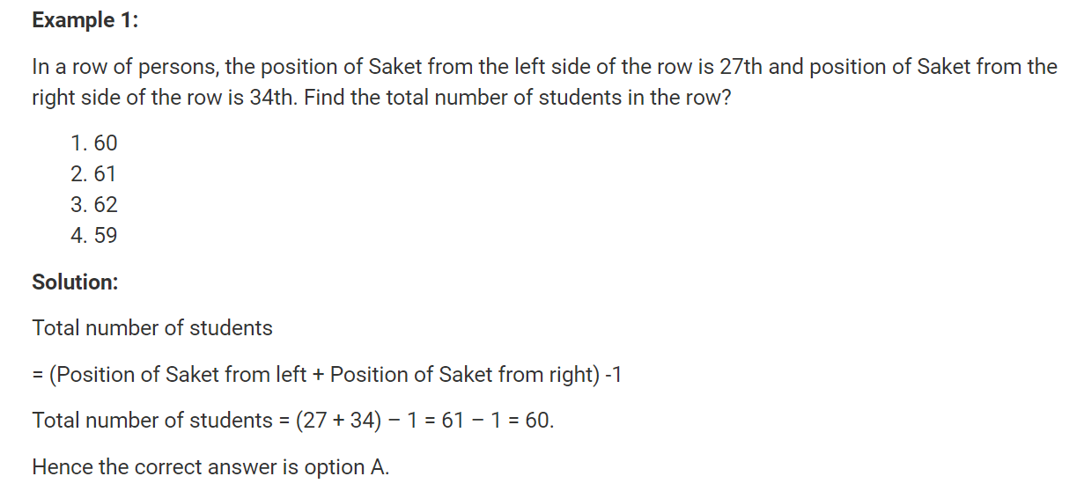

Slide 4
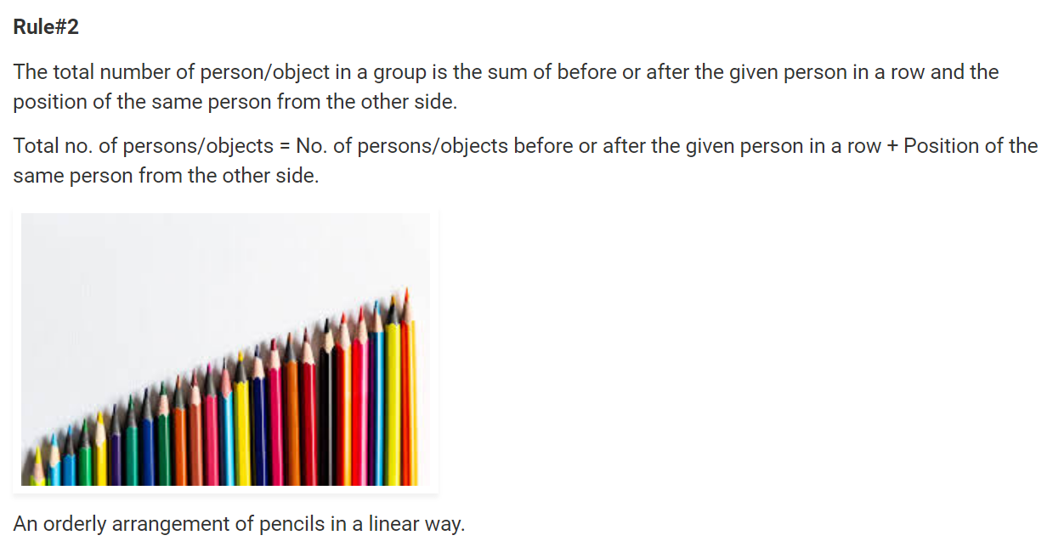

Slide 5
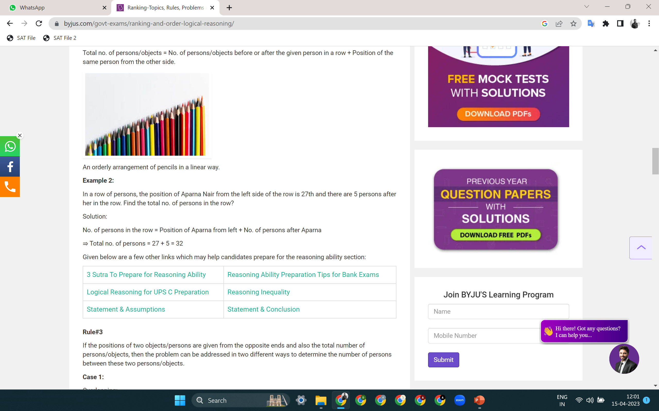

Slide 6
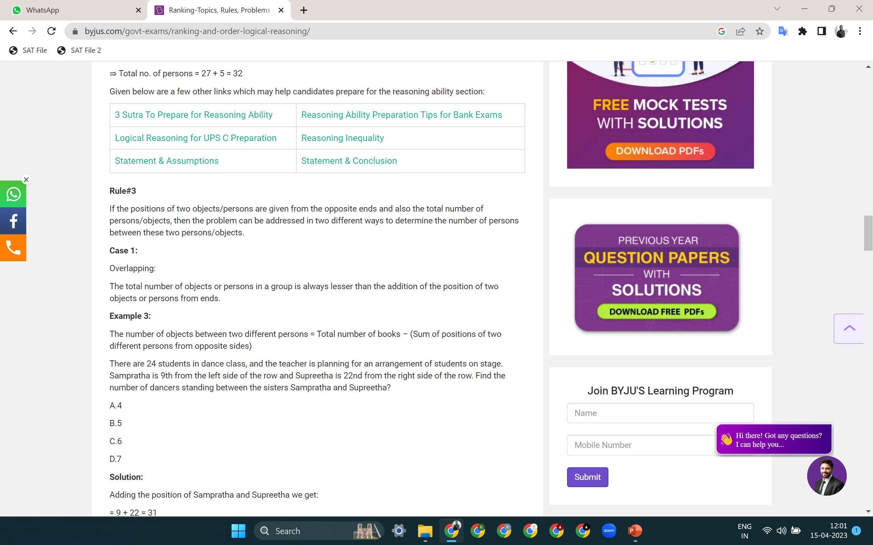

Slide 7
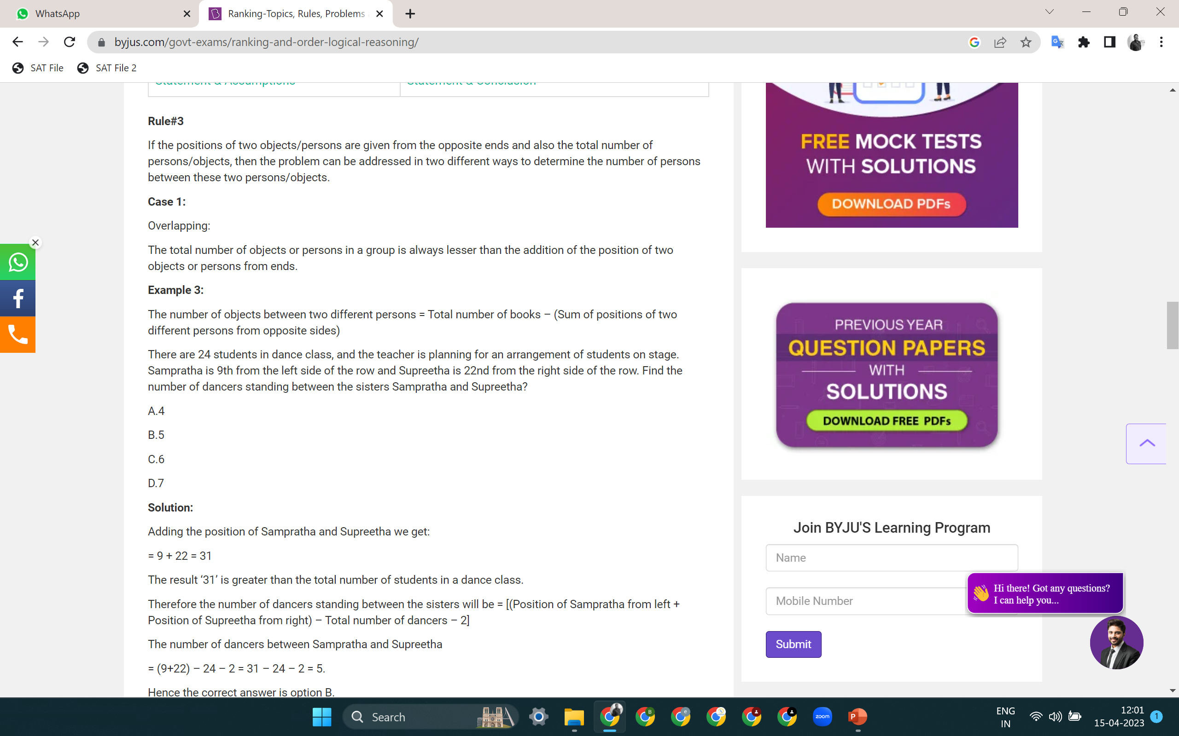

Slide 8
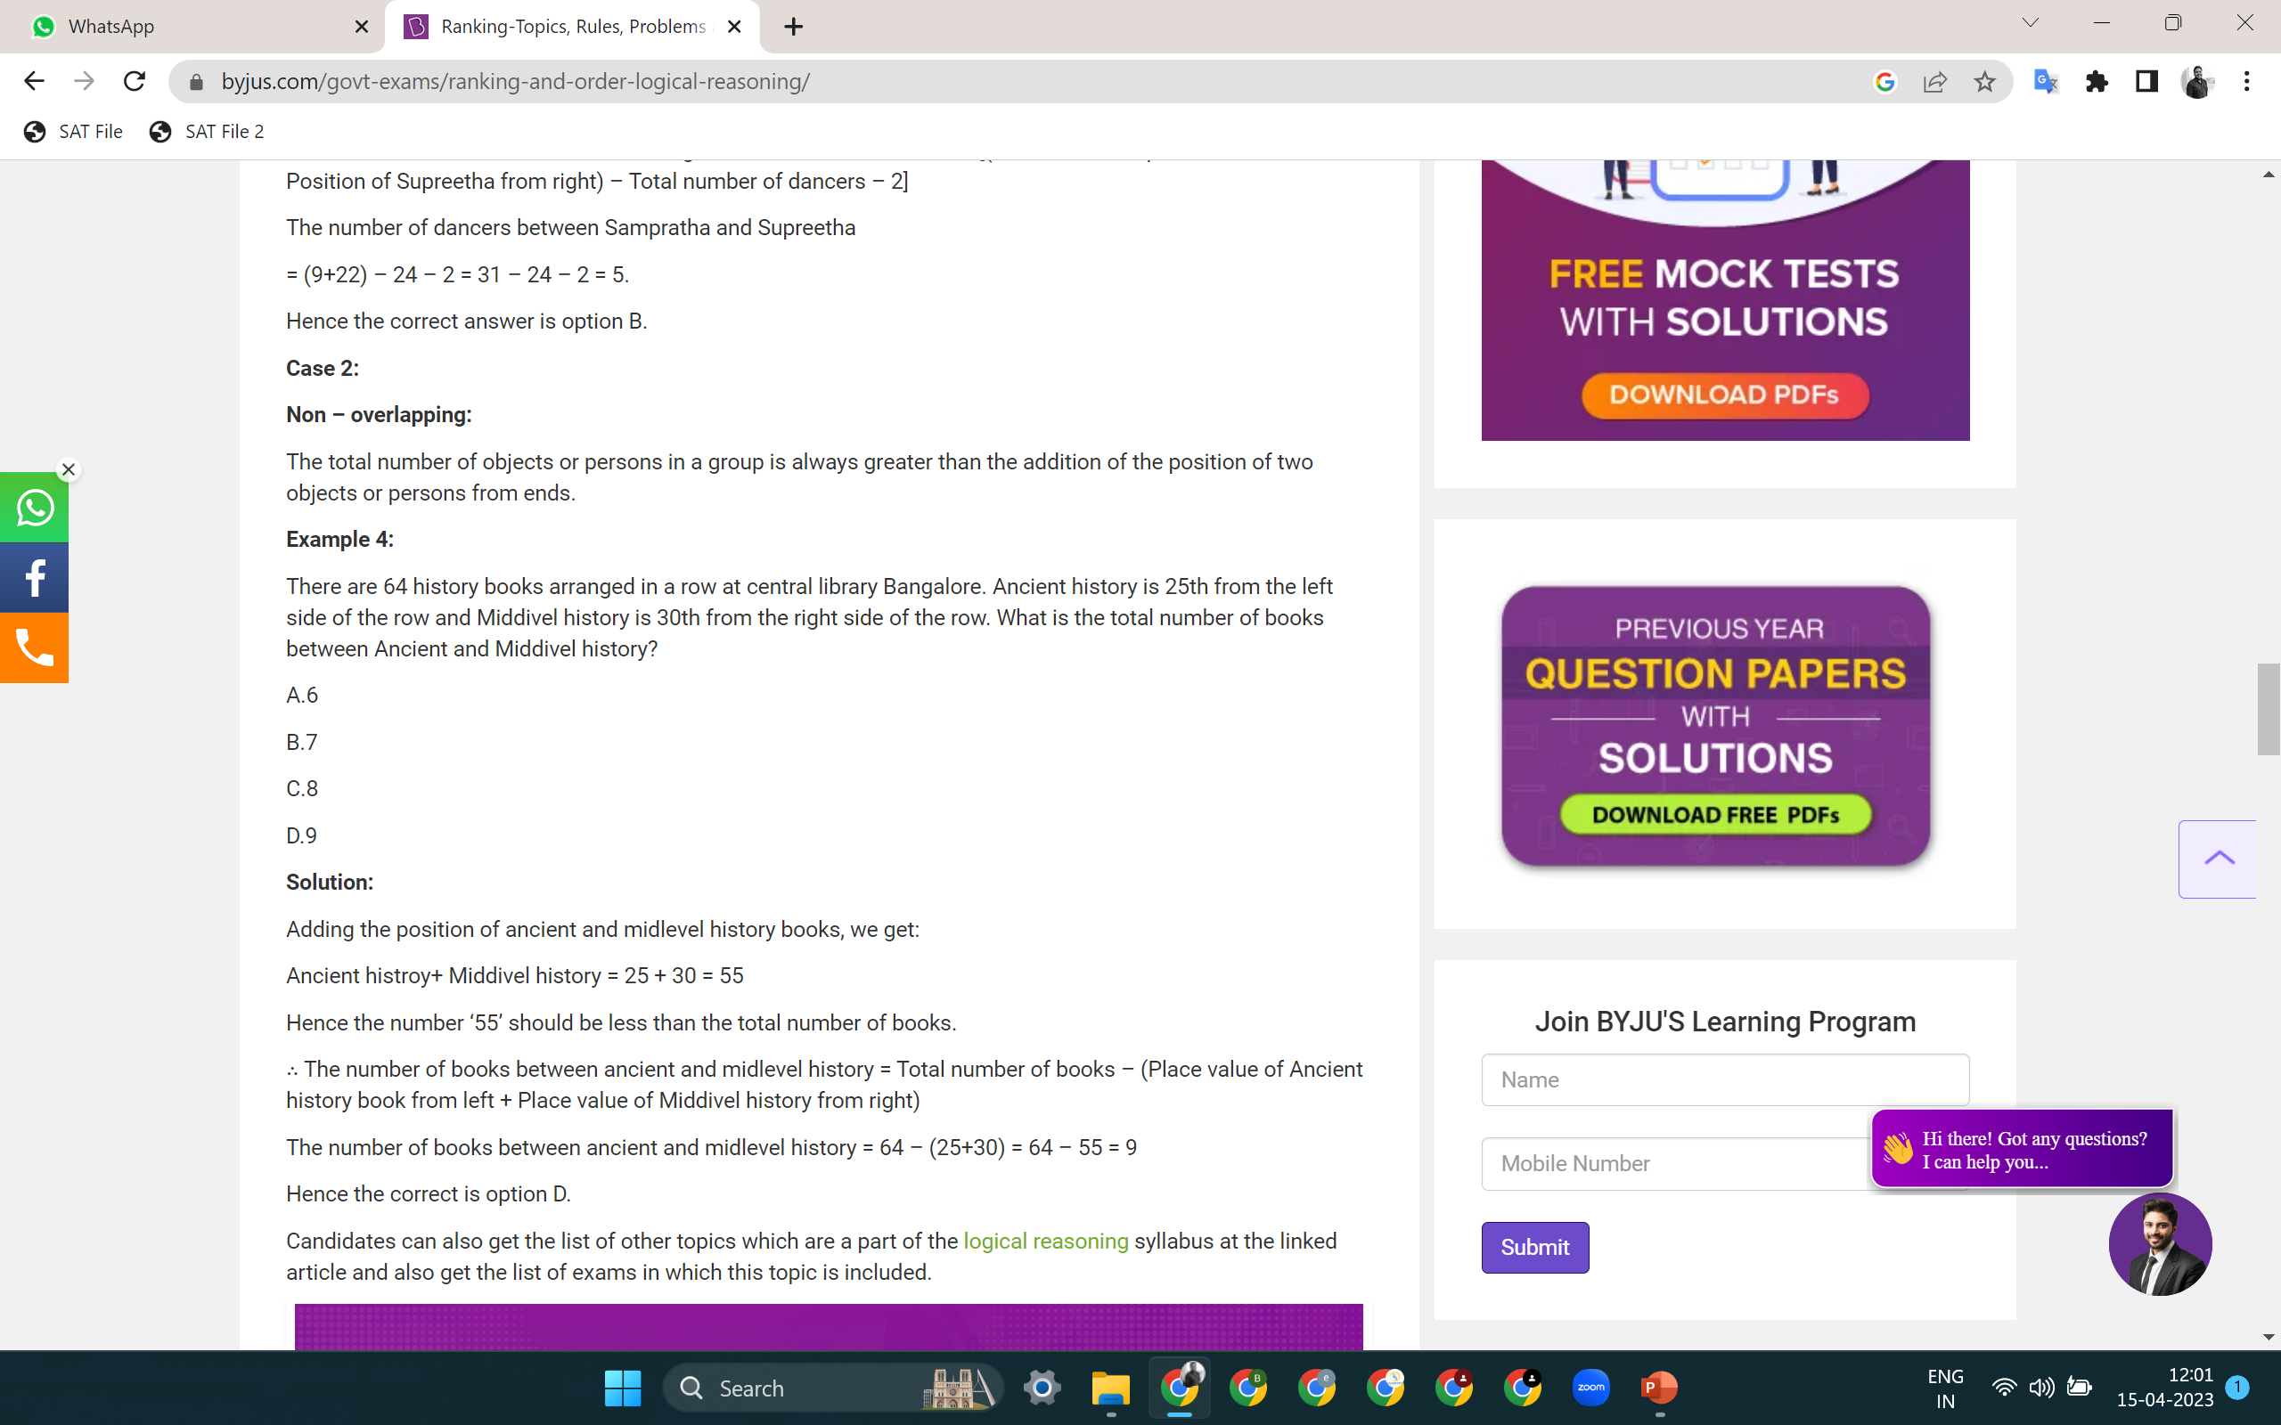

Slide 9
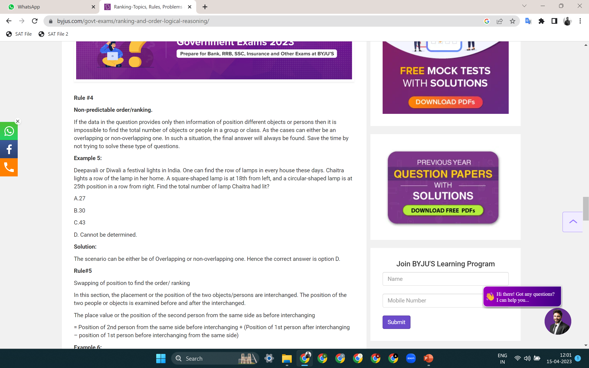

Slide 10
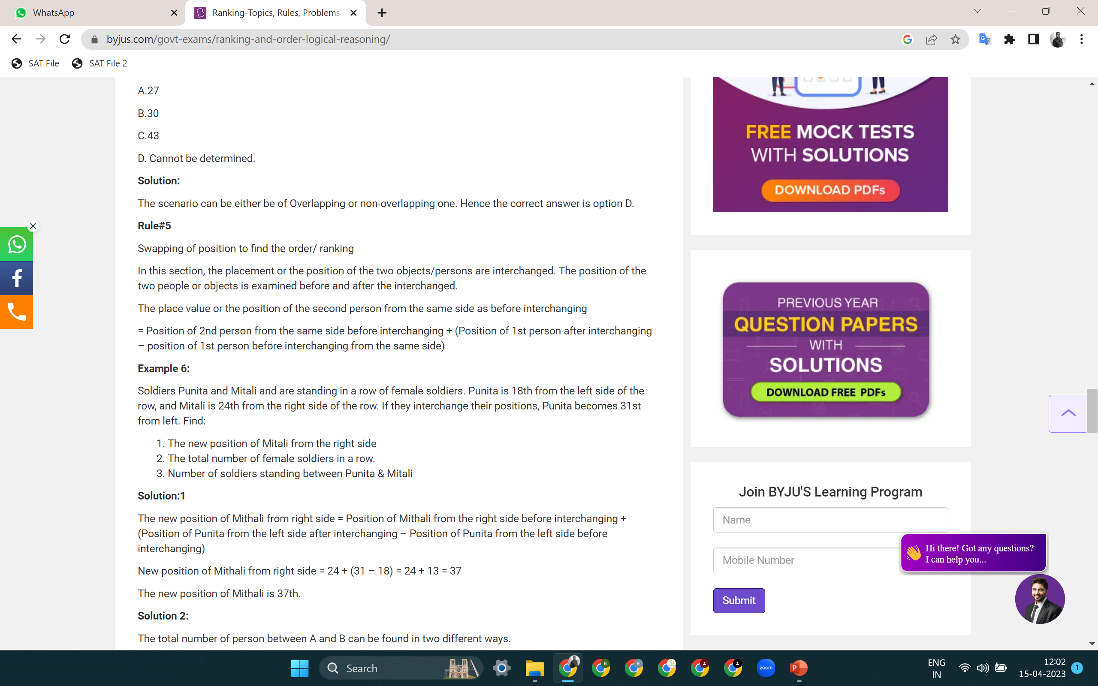

Slide 11


Slide 12
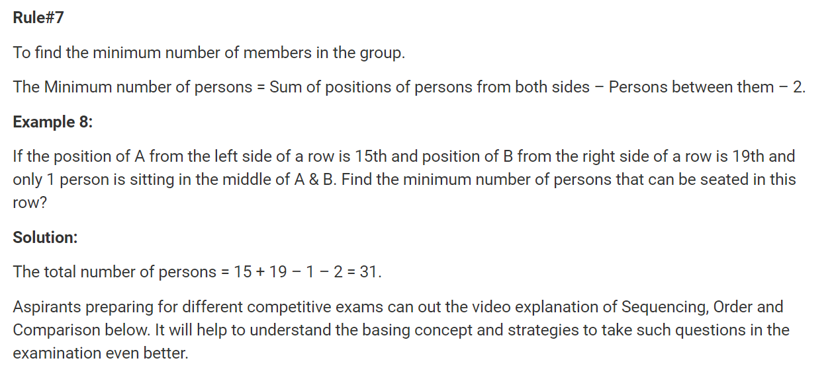

Slide 13
RANKING ARRANGEMENT
Q 1. In a Queue Ram is 11th from top and 22th from bottom then total no. of students are?
(a) 34 (b) 33 (c) 32 (d) 31

Slide 14
RANKING ARRANGEMENT
Q 1. In a Queue Ram is 11th from top and 22th from bottom then total no. of students are?
(a) 34 (b) 33 (c) 32 (d) 31

Slide 15
RANKING ARRANGEMENT
Q 2. In a row of 57 boys Mohan is 21th from left end then what is his position from right end.
(a) 36 (b) 37 (c) 35 (d) 34

Slide 16
RANKING ARRANGEMENT
Q 2. In a row of 57 boys Mohan is 21th from left end then what is his position from right end.
(a) 36 (b) 37 (c) 35 (d) 34

Slide 17
RANKING ARRANGEMENT
Q 3. In a queue of 81 girls Vibha’s position from end is 30th. What is Vibha’s position from starting.
(a) 51 (b) 52 (c) 50 (d) 60

Slide 18
RANKING ARRANGEMENT
Q 3. In a queue of 81 girls Vibha’s position from end is 30th. What is Vibha’s position from starting.
(a) 51 (b) 52 (c) 50 (d) 60

Slide 19
RANKING ARRANGEMENT
Q 4. Amar ranked sixteenth from the top and twenty-ninth from the bottom among those who passed an examination. Six boys did not participate in the competition and five failed in it. How many boys were there in the class?
(a) 40 (b) 44 (c) 50 (d) 55

Slide 20
RANKING ARRANGEMENT
Q 4. Amar ranked sixteenth from the top and twenty-ninth from the bottom among those who passed an examination. Six boys did not participate in the competition and five failed in it. How many boys were there in the class?
(a) 40 (b) 44 (c) 50 (d) 55

Slide 21
RANKING ARRANGEMENT
Q 5. If Vikash finds that he is twelfth from the right and fourth from the left, how many boys should be added to the queue so that there are 28 boys in the line?
(a) 12 (b) 13 (c) 14 (d) 20

Slide 22
RANKING ARRANGEMENT
Q 5. If Vikash finds that he is twelfth from the right and fourth from the left, how many boys should be added to the queue so that there are 28 boys in the line?
(a) 12 (b) 13 (c) 14 (d) 20

Slide 23
RANKING ARRANGEMENT
Q 6. In a row of boys, Jeevan is seventh from the start and eleventh from the end. In another row of boys, Vikas is tenth from the start and twelfth from the end. How many boys are there in both the rows together?
(a) 36 (b) 37 (c) 39 (d) none of these

Slide 24
RANKING ARRANGEMENT
Q 6. In a row of boys, Jeevan is seventh from the start and eleventh from the end. In another row of boys, Vikas is tenth from the start and twelfth from the end. How many boys are there in both the rows together?
(a) 36 (b) 37 (c) 39 (d) none of these

Slide 25
RANKING ARRANGEMENT
Q 7. In a class of 48 students Mona’s position is 12th. If two new students join the class (they are more intelligent to Mona in study). Then what is Mona’s position from opposite side.
(a)35 (b) 34 (c) 36 (d) 37

Slide 26
RANKING ARRANGEMENT
Q 7. In a class of 48 students Mona’s position is 12th. If two new students join the class (they are more intelligent to Mona in study). Then what is Mona’s position from opposite side.
(a)35 (b) 34 (c) 36 (d) 37

Slide 27
RANKING ARRANGEMENT
Q 8. In a row of boys, A is thirteenth from the left end, D is seventeenth from the right. If in this row A is eleventh from the right then what is the position of D from the left?
(a) 6th (b) 7th (c) 10th (d) 12th

Slide 28
RANKING ARRANGEMENT
Q 8. In a row of boys, A is thirteenth from the left end, D is seventeenth from the right. If in this row A is eleventh from the right then what is the position of D from the left?
(a) 6th (b) 7th (c) 10th (d) 12th

Slide 29
RANKING ARRANGEMENT
Q 9. Mohan is thirteenth from the left end in a row of children. Praveen is twelfth from the right end and eighteenth from the left end. How many children are towards the right of Mohan in that row?
(a) 16 (b) 18 (c) 17 (d) Can’t be determined

Slide 30
RANKING ARRANGEMENT
Q 9. Mohan is thirteenth from the left end in a row of children. Praveen is twelfth from the right end and eighteenth from the left end. How many children are towards the right of Mohan in that row?
(a) 16 (b) 18 (c) 17 (d) Can’t be determined

Slide 31
RANKING ARRANGEMENT
Q 10. In a row of girls, there are 16 girls between Priya and Natasha. priya is thirty-second from the left end of the row. If Priya is nearer than Natasha to the right end of the row, then how far away is natasha from the left end of the row?
(a) Data inadequate (b) 14th (c) 15th (d) 16th

Slide 32
RANKING ARRANGEMENT
Q 10. In a row of girls, there are 16 girls between Priya and Natasha. priya is thirty-second from the left end of the row. If Priya is nearer than Natasha to the right end of the row, then how far away is natasha from the left end of the row?
(a) Data inadequate (b) 14th (c) 15th (d) 16th

Slide 33
RANKING ARRANGEMENT
Q 11. In a row of boys , if A who is tenth from the left and B who is ninth from the right interchange their positions, A becomes fifteenth from the left. How many boys are there in the row?
(a) 23 (b) 27 (c) 28 (d) 31

Slide 34
RANKING ARRANGEMENT
Q 11. In a row of boys , if A who is tenth from the left and B who is ninth from the right interchange their positions, A becomes fifteenth from the left. How many boys are there in the row?
(a) 23 (b) 27 (c) 28 (d) 31

Slide 35
RANKING ARRANGEMENT
Q 12. In a row of children, Deepti is ninth from the left and kashish is thirteenth from the right. They exchange their positions and then Deepti becomes seventeenth from the left. Find the new position of Kashish from the right end of the row.
(a) 20 (b) 21 (c) 27 (d) 31

Slide 36
RANKING ARRANGEMENT
Q 12. In a row of children, Deepti is ninth from the left and kashish is thirteenth from the right. They exchange their positions and then Deepti becomes seventeenth from the left. Find the new position of Kashish from the right end of the row.
(a) 20 (b) 21 (c) 27 (d) 31

Slide 37
RANKING ARRANGEMENT
Q 13. In a queue of boy Shailesh is 20th from starting and Anish is 15th from end. There are 14 person between them. What is the maximum number of person in queue?
(a) 44 (b) 43 (c) 49 (d) 45

Slide 38
RANKING ARRANGEMENT
Q 13. In a queue of boy Shailesh is 20th from starting and Anish is 15th from end. There are 14 person between them. What is the maximum number of person in queue?
(a) 44 (b) 43 (c) 49 (d) 45

Slide 39
RANKING ARRANGEMENT
Q 14. In a row of girls Seema is 20th from starting and Rina is 25th from end. There are 8 girls between them. Total number of girls are?
(a) 35 (b) 53 (c) 55 (d) either 35 or 53

Slide 40
RANKING ARRANGEMENT
Q 14. In a row of girls Seema is 20th from starting and Rina is 25th from end. There are 8 girls between them. Total number of girls are?
(a) 35 (b) 53 (c) 55 (d) either 35 or 53

Slide 41
RANKING ARRANGEMENT
Q 15. In a queue of 20 boys, D is fourteenth from the front and F is ninth from the bottom. How many boy are there between D and F?
(a) 2 (b) 3 (c) 1 (d) Data inadequate

Slide 42
RANKING ARRANGEMENT
Q 15. In a queue of 20 boys, D is fourteenth from the front and F is ninth from the bottom. How many boy are there between D and F?
(a) 2 (b) 3 (c) 1 (d) Data inadequate

Slide 43
RANKING ARRANGEMENT
Q 16. In a row of students, Ramesh in 12th from the left and Kashi is 17th from the right. When Ramesh and Kashi interchange their positions, Kashi becomes 27th from the right. How many students are there between Kashi and Ramesh?
(a) 9 (b) 12 (c) 7 (d) 10

Slide 44
RANKING ARRANGEMENT
Q 16. In a row of students, Ramesh in 12th from the left and Kashi is 17th from the right. When Ramesh and Kashi interchange their positions, Kashi becomes 27th from the right. How many students are there between Kashi and Ramesh?
(a) 9 (b) 12 (c) 7 (d) 10

Slide 45
RANKING ARRANGEMENT
Q 17. In a class of 60, Where girls are twice to of boys, Kamal ranked sixteenth from top. If there are 9 girls ahead of Kamal, how many boys are after him in rank?
(a) 13 (b) 7 (c) 12 (d) 23

Slide 46
RANKING ARRANGEMENT
Q 17. In a class of 60, Where girls are twice to of boys, Kamal ranked sixteenth from top. If there are 9 girls ahead of Kamal, how many boys are after him in rank?
(a) 13 (b) 7 (c) 12 (d) 23

Slide 47
RANKING ARRANGEMENT
Q 18. Ravi is 7 ranks ahead of Sumit in a class of 39 students. If Sumit’s rank is seventeenth from the last, what is Ravi’s rank from the start?
(a) 14th (b) 15th (c) 16th (d) 17th

Slide 48
RANKING ARRANGEMENT
Q 18. Ravi is 7 ranks ahead of Sumit in a class of 39 students. If Sumit’s rank is seventeenth from the last, what is Ravi’s rank from the start?
(a) 14th (b) 15th (c) 16th (d) 17th

Slide 49
RANKING ARRANGEMENT
Q 19. In a row of boys, A is fifteenth from the left and B is 4th from the right. There are three boys between A and B. C is just left of A. What is C’s position from the right?
(a) 9th (b) 10th (c) 12th (d) 13th

Slide 50
RANKING ARRANGEMENT
Q 19. In a row of boys, A is fifteenth from the left and B is 4th from the right. There are three boys between A and B. C is just left of A. What is C’s position from the right?
(a) 9th (b) 10th (c) 12th (d) 13th

Slide 51
RANKING ARRANGEMENT
Q 20. In a row of forty children, P is thirteenth from the left end, Q is ninth from the right end. How many children are there between P and R if R is fourth to the left of Q
(a) 12 (b) 13 (c) 14 (d) 15

Slide 52
RANKING ARRANGEMENT
Q 20. In a row of forty children, P is thirteenth from the left end, Q is ninth from the right end. How many children are there between P and R if R is fourth to the left of Q
(a) 12 (b) 13 (c) 14 (d) 15

Slide 53
RANKING ARRANGEMENT
Q 21. In a queue, Shikhar is ninth from the back. Arun’s place is eight from the front. Nikhil is standing between the two. What could be the minmum number of boys standing in the queue?
(a) 8 (b) 10 (c) 12 (d) 14

Slide 54
RANKING ARRANGEMENT
Q 21. In a queue, Shikhar is ninth from the back. Arun’s place is eight from the front. Nikhil is standing between the two. What could be the minmum number of boys standing in the queue?
(a) 8 (b) 10 (c) 12 (d) 14

Slide 55
RANKING ARRANGEMENT
Q 22. In a row of 21 girls when Monika was shifted by 4 places towards the right, she became 12th from the left end. what was her earlier position from the right end of the row?
(a) 9th (b) 10th (c) 11th (d) 12th (e) 14th

Slide 56
RANKING ARRANGEMENT
Q 22. In a row of 21 girls when Monika was shifted by 4 places towards the right, she became 12th from the left end. what was her earlier position from the right end of the row?
(a) 9th (b) 10th (c) 11th (d) 12th (e) 14th

Slide 57
RANKING ARRANGEMENT
Q 23. In a queue of thirty boys, M is eighth from the end and J is twelfth from the front. If there are six boys between J and Q, How many boys are there between M and Q?
(a) 10 (b) 12 (c) 8 (d) data inadequate

Slide 58
RANKING ARRANGEMENT
Q 23. In a queue of thirty boys, M is eighth from the end and J is twelfth from the front. If there are six boys between J and Q, How many boys are there between M and Q?
(a) 10 (b) 12 (c) 8 (d) data inadequate

Slide 59
THANK YOU

